Slide 1
Customer Personality Analysis
Atefeh Kheirollahi
Oct 22nd, 2024

Slide 2

Customer Personality Analysis
Research Objective
Understanding customer engagement and personal behavior patterns to improve targeted marketing strategy:
Modify marketing strategies according to the specific needs, behavior and concerns of different types of customers:
Enhance customer loyalty and retention
Higher sales and revenue growth
Better allocation of marketing resources

Slide 3
Data Sources Used
Demographic Data
Transactional Data
Marketing Engagement Data
Product-Based Data
Data Source: https://www.kaggle.com/datasets/imakash3011/customer-personality-analysis/data

Slide 4
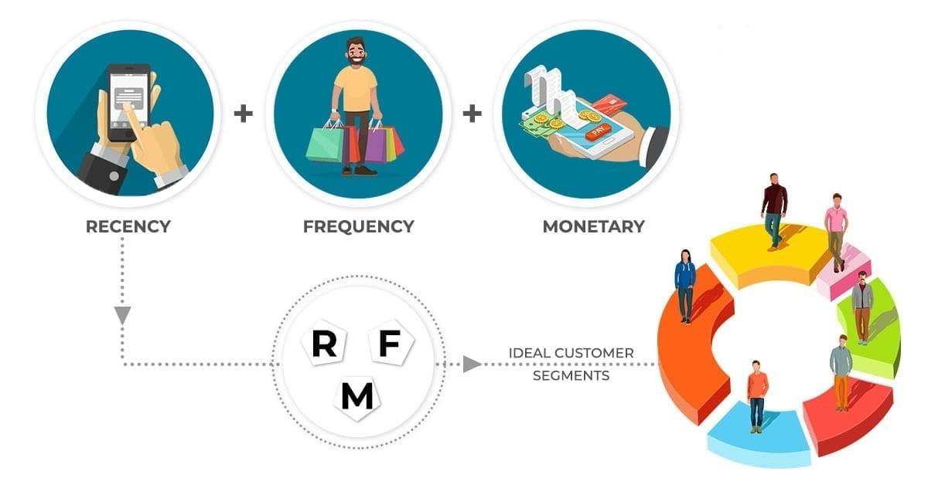
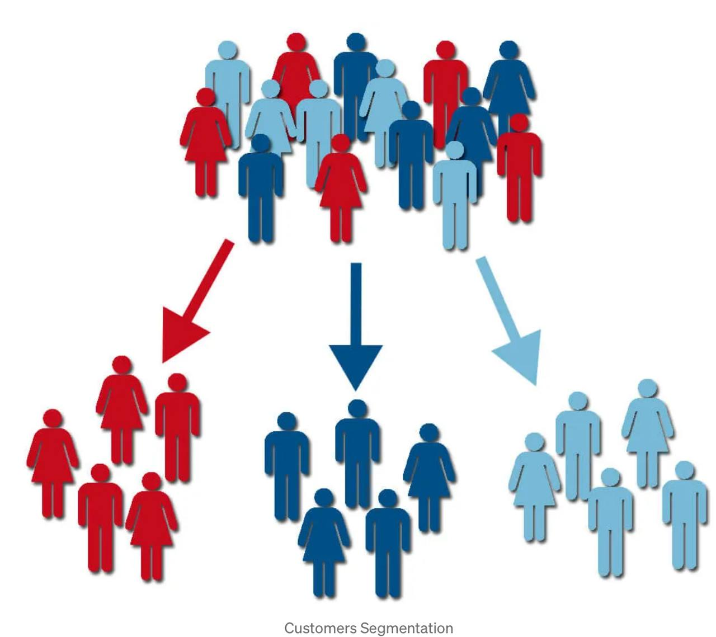
Methodology
Methodology
RFM Analysis
Recency: number of days since a costumer last purchase
Frequency: number of unique invoices associated with each costumer
Monetary: total amount spent by each costumer
Clustering
Statistical modeling (K-means algorithm)
Elbow method for optimal cluster number

Slide 5
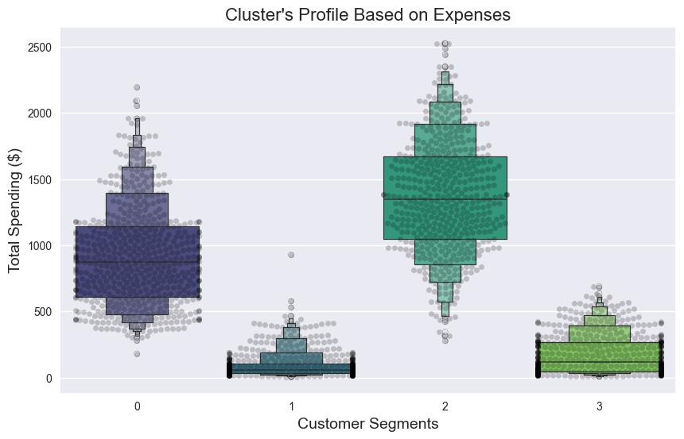
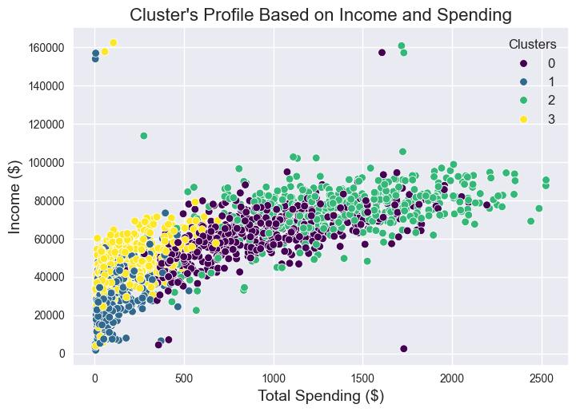
Spending Pattern
Cluster 2 has the highest income resulting in having highest spending with an average 1400$
Custer 1 and 3 have the lowest income resulting in having lowest spending with less than 500$

Slide 6
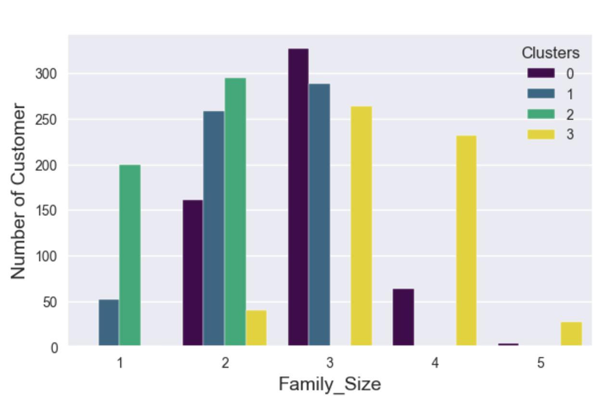
Family Size Analysis
Cluster 0 mostly has the family size of 3 members with one child
Cluster 1 is mostly couple with one child
Cluster 2 is definitely not a parent at a maximum 2 members in family
Cluster 3 is definitely a parent with maximum 3 children

Slide 7
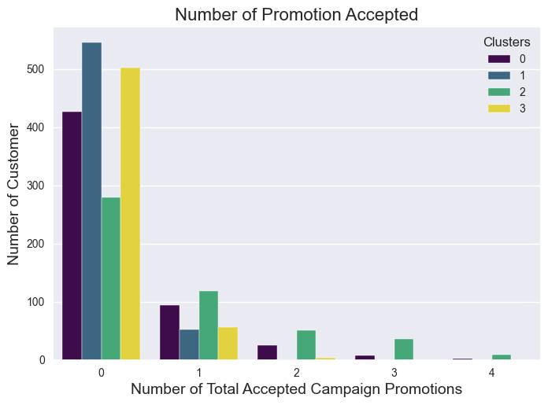
Marketing Analysis: Promotional Engagement
Very low engagement between all clusters for promotional offers
Low interest in sales products between clusters 1, 2 and 3
Better plan for promotional offers is needed to improve sales
Implement different approaches to engage these groups in sales effectively

Slide 8
Customer Purchase Method
Cluster 2 is primary user of catalogs, and cluster 0 shows some interest
 | Website | In store | Catalog
Cluster 0 | 35.53% | 43.56% | 20.9%
Cluster 1 | 36.30% | 54.6% | 9.1%
Cluster 2 | 26.19% | 43.36% | 30.45%
Cluster 3 | 36.13% | 52.05% | 11.82%
Reduce investment in catalog marketing for cluster 1 and 3
Clusters 1 and 3 prefer in person purchasing while cluster 0 and 2 show interest in online purchasing
Invest in digital marketing and personalize online offer for clusters 0 and 2

Slide 9
Cluster 0:
Average income 60K
A family size of 3 members with one child
Highly interested in purchasing using discount
Loyal/regular costumer and moderate spending
Cluster 1:
Low income with average 30K
Low expenses with average 100$
Mostly couple, at the max with one child
At risk costumers (not purchased in a long time)
Relatively younger costumers with average 44
Cluster 2:
High income with average 80K
High expenses with the average 1300$
Not a parent at a maximum 2 members in family
Lowest website visit
Cluster 3:
Low income with average 40K
Low expenses with average 100$
A parent with maximum 3 children
Low loyalty costumers with average 280 days
At risk costumers (not purchased in a long time)

Slide 10
Cluster 0
Offer subscription services for family essentials with a discount for subscribers
Offer exclusive discounts or coupon codes for loyal customers through a VIP or loyalty program
Cluster 1 and 3
Offer interest-free installment plans
Promote limited-time, low-cost offers on essentials via personalized emails or SMS
Launch a simple loyalty program with immediate rewards to re-engage customers
Cluster 2
Send personalized emails showcasing new products that align with their preferences and previous purchases
Include free samples of new products with their online or in-store purchases

Slide 11



Q and A
https://github.com/akheirollahi/Customer-Personality-Analysis

